Slide 1
Image Compression
Chapter 8
Imran Siddiqi
imran.siddiqi@mcs.edu.pk
Computer Science Department
College of Telecommunication Engineering
National University of Sciences and Technology

Slide 2
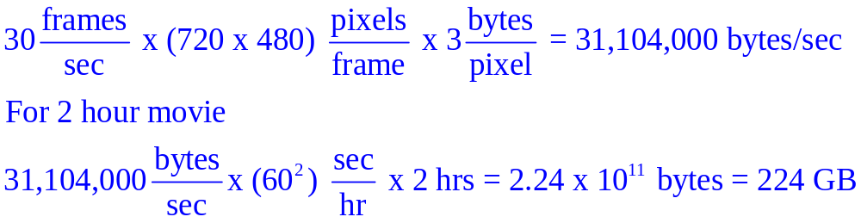
Motivation
Storage needed for a two-hour standard television movie (Color)
  Image size = 720 x 480 pixels
  Frame rate = 30 fps (frame per seconds)

Slide 3
Image compression
Principal objective
To minimize the number of bits required to represent an image
Applications
  Transmission: Broadcast TV, remote sensing via satellite, military communications via aircraft, radar and sonar, teleconferencing, computer communications, …
  Storage: Educational and business documents, medical images (CT, MRI and digital radiology), motion pictures, satellite images, weather maps, geological surveys, ...

Slide 4
Overview
Image data compression methods fall into two common categories:
Information preserving compression
  Especially for image archiving (storage of legal or medical records)
  Compress and decompress images without losing information
Lossy image compression
  Provide higher levels of data reduction
  Result in a less than perfect reproduction of the original image

Slide 5
Data vs. Information
Data are the means to convey information; various amounts of data may be used to represent the same amount of information
Part of data may provide no relevant information: data redundancy

Slide 6
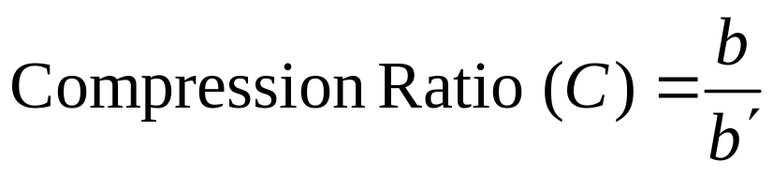
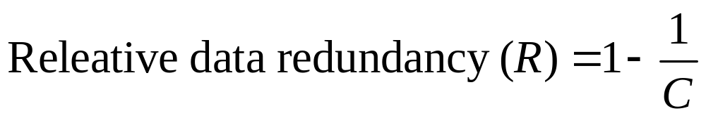
Relative data redundancy
Let b and b’ refer to amounts of data in two data sets that carry the same information
of the first dataset b
if b = b’, C = 1 and R = 0, relative to the second data set, the first set contains no redundant data
if b >> b’, C → ∞ and R → 1, relative to the second data set, the first set contains highly redundant data
if b << b’, C → 0 and R → -∞, relative to the second data set, the first set is highly compressed
C = 10 means 90% of the data in the first data set is redundant

Slide 7
Data redundancy
Image compression techniques can be designed by reducing or eliminating the data redundancy
Three basic data redundancies
  Coding redundancy
  Spatial and Temporal redundancy
  Irrelevant information

Slide 8
Coding redundancy
A natural m-bit coding method assigns m-bit to each gray level without considering the probability that gray level occurs
→ very likely to contain coding redundancy
Basic concept
  Utilize the probability of occurrence of each gray level (histogram) to determine length of code representing that particular gray level: variable-length coding
  Assign shorter code words to the gray levels that occur most frequently or vice versa

Slide 9
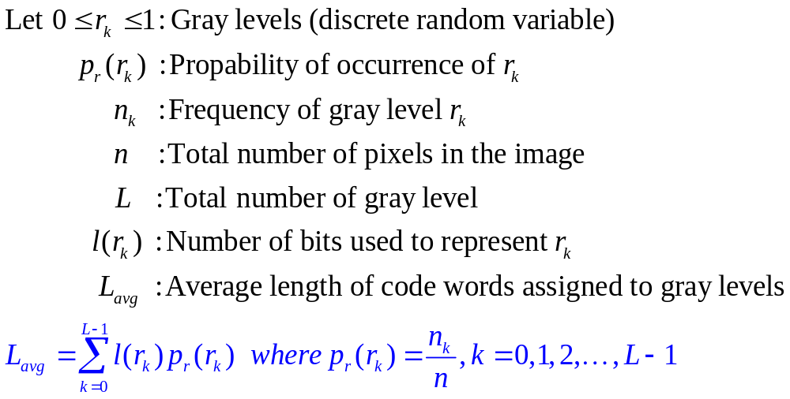
Coding redundancy
Hence, the total number of bits required to code and MxN pixel image is MNL_{avg}
For a natural m-bit coding L_{avg}= m

Slide 10

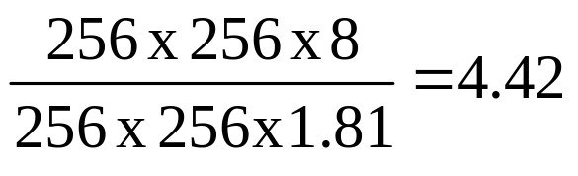
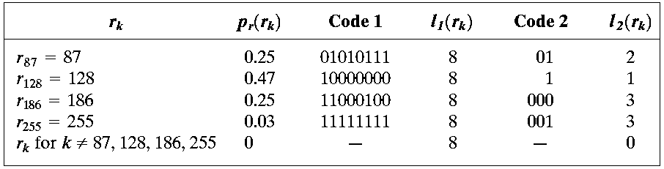
Coding redundancy: Example
Code 1: Natural code (m = 8) is used,
L_{avg} = 8 bits
Code 2: Variable length code
L_{avg} = (0.25)2 + 0.47(1) + 0.25(3) + 0.03(3)
= 1.81 bits
Compression Ratio =
R = 1 – 1/4.42 = 0.774
A computer generated (synthetic) 8-bit image M = N = 256

Slide 11
Coding redundancy: Example
Code 1: Natural code (m = 8) is used,
L_{avg} = 8 bits
Code 2: Variable length code
L_{avg} = (0.25)2 + 0.47(1) + 0.25(3) + 0.03(3)
= 1.81 bits
Compression Ratio =
R = 1 – 1/4.42 = 0.774
A computer generated (synthetic) 8-bit image M = N = 256
77.4% data in the image is redundant

Slide 12
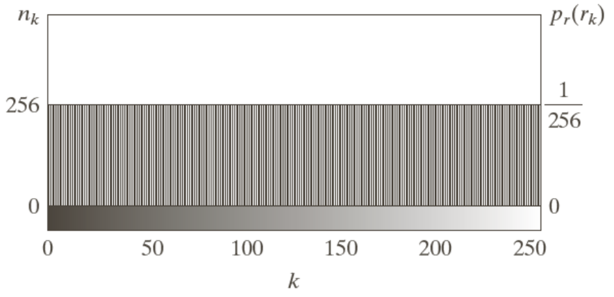
Spatial and Temporal redundancy
Image features
  All 256 gray levels are equally probable → uniform histogram
  (variable length coding can not be applied)
  The gray levels of each line are selected randomly so pixels are independent of one another in vertical direction
  Pixels along each line are identical, they are completely dependent on one another in horizontal direction
A computer generated (synthetic) 8-bit image
M = N = 256
Spatial redundancy

Slide 13
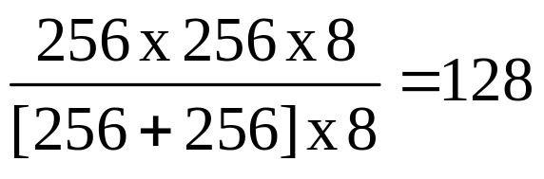
Spatial and Temporal redundancy
The spatial redundancy can be eliminated by using run-length pairs (a mapping scheme)
Run length pairs has two parts
  Start of new intensity
  Number of consecutive pixels having that intensity
Example (consider the image shown in previous slide)
  Each 256 pixel line of the original image is replaced by a single 8-bit intensity value
  Length of consecutive pixels having the same intensity = 256
  Compression Ratio =

Slide 14
Spatial and Temporal redundancy
In general, gray level of any given pixel can be reasonably predicted from the value of its neighbors (information carried by individual pixels is relatively small)
To reduce the spatial (or temporal) redundancy, mapping is used.
  Example: Map pixels of an image: f(x,y) to a sequence of pairs
  (g₁,r₁), (g₂,r₂), ..., (g_{i},r_{i}), ...
  g_{i}: i^{th} gray level r_{i}: run length of the i^{th} run

Slide 15
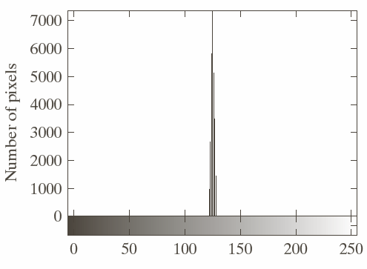
Irrelevant information
The eye does not respond with equal sensitivity to all visual information
Certain information has less relative importance than other information in normal visual processing
The elimination of visually redundant data results in a loss of quantitative information → lossy data compression method
A computer generated (synthetic) 8-bit image
M = N = 256
This image appears homogeneous so we can use its mean value to encode this image
Histogram of
the image

Slide 16


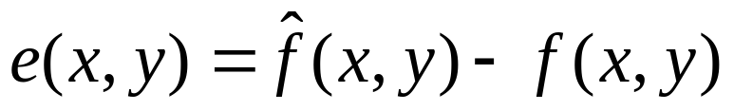
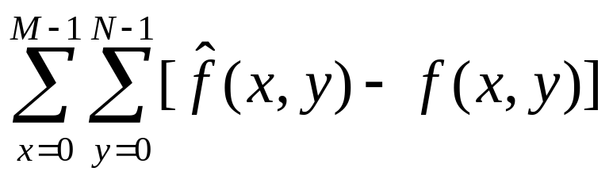
Fidelity Criteria
Quantify the nature and extent of information loss
Level of information loss can be expressed as a function of the original (input) and compressed-decompressed (output) image
Given an MxN image , its compressed-then-decompressed image , then the error between corresponding values is given by
Total Error:

Slide 17
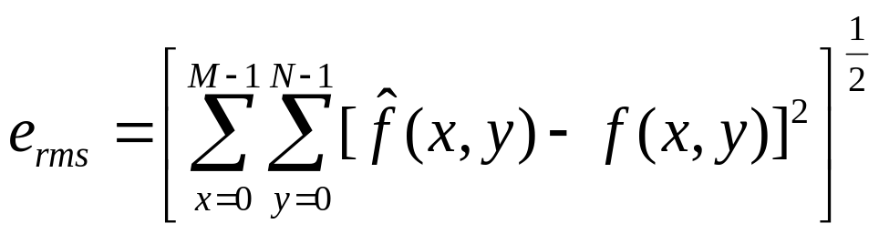
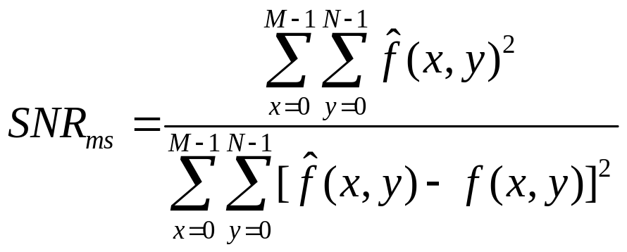
Fidelity Criteria
Normally the objective fidelity criterion parameters are as follows:
Root mean square error:
Mean-square signal-to-noise ratio

Slide 18
References
Chapter #8: Digital Image Processing by Rafael C. Gonzales & Richard E. Woods

